Slide 1

insertion sort algorithm & implementation in java
-- #greenlearner --

Slide 2
Input/output
Input
Unsorted integer elements
Output
Sorted integer array
9 | 8 | 7 | 6 | 5 | 4
4 | 5 | 6 | 7 | 8 | 9

Slide 3
Steps/Algorithm
Start from the first element in for loop i=0
Pick the element at index j+1(j=0,1,2..i) and
compare it with it’s left side and put at sorted position
Move pointer right by 1
Move pointer to the right by 1 position
Repeat till the last element
9 | 8 | 7 | 6 | 5 | 4
8 | 9 | 7 | 6 | 5 | 4
7 | 8 | 9 | 6 | 5 | 4
6 | 7 | 8 | 9 | 5 | 4
5 | 6 | 7 | 8 | 9 | 4
4 | 5 | 6 | 7 | 8 | 9

Slide 4
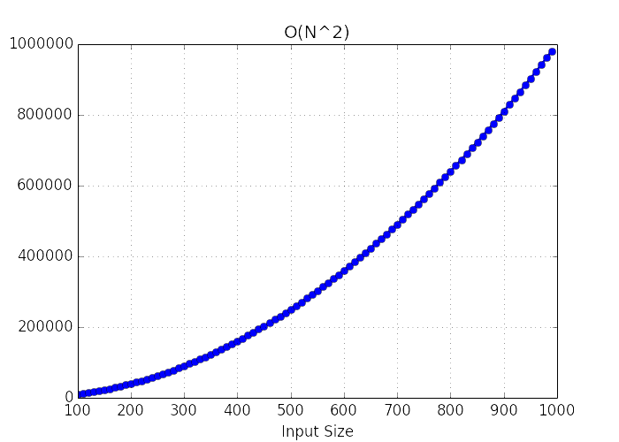
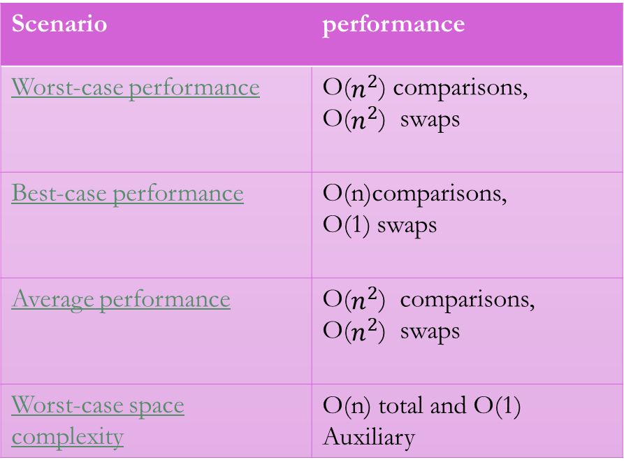
Performance
Scenario | performance
Worst-case performance | O($n^{2}$) comparisons, O($n^{2}$) swaps
Best-case performance | O(n)comparisons, O(1) swaps
Average performance | O($n^{2}$) comparisons, O($n^{2}$) swaps
Worst-case space complexity | O(n) total and O(1) Auxiliary

Slide 5
Where and when to use??
Efficient for data sets that are already substantially sorted
Does not change the relative order of elements with equal keys
When people manually sort cards in a bridge hand, most use a method that is similar to insertion sort

Slide 6
References
https://en.wikipedia.org/wiki/Insertion_sort

Slide 7
Next..
Selection sorting algorithm..

